Slide 1

DIGITAL DESIGN AND COMPUTER ORGANIZATION
Addressing Modes T2: Chapter 2: 2.5
Department of Computer Science and Engineering

Slide 2
Introduction(T2- section 2.5)
Situations like program looping, branching demand convenient ways of locating memory words or memory operands.
This convenience is being offered by different instructions (of a particular instruction set as defined by the Microprocessor) via various Addressing Modes they support.
Suppose a given memory operand address is too large to fit into a given instruction format (i.e., in operand field), then it is the addressing mode (say Register Indirect Mode ) that can resolve this problem.

Slide 3
Addressing Modes Introduction
What is Addressing Mode . . . ?
The different ways in which the location of an operand is specified in an instruction are referred to as addressing modes

Slide 4

Addressing Modes Introduction
What is Addressing Mode . . . ?
The addressing mode specifies a rule or method for interpreting or modifying the address field of the instruction before the operand is actually accessed for manipulation.
It is concerned with the different ways in which the location of an operand can be specified in a given instruction.
Various schemes for specifying addresses of operands in an instruction have been introduced. Such schemes are collectively known as Addressing Modes.

Slide 5
Addressing Modes Introduction
Advantages of Addressing modes :
To be able to reference large number of memory location in main memory or for some system in virtual memory.
To reduce number of bits in the address field of an instruction
To extend programming convenience to the user / programmer by providing such facilities as indexing of set of data values, counters for loop control, pointers to memory locations

Slide 6
Addressing Modes Outline
Immediate mode
Absolute (Direct) mode
Register mode
Indirect mode
Indexed mode
Relative mode
Auto increment mode
Auto decrement mode

Slide 7
DIGITAL DESIGN AND COMPUTER ORGANIZATION
1. Immediate mode T2:Ch2 2.5
Department of Computer Science and Engineering

Slide 8
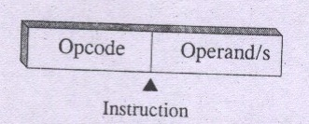
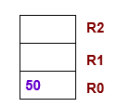
Immediate mode
Here the operand is specified in the instruction itself. An instruction that follows immediate mode has an operand field rather than an address field.
For example:
Move 50_{immediate}, R0
A common convention say, a symbol # has to precede the value of an immediate operand
Move #50, R0

Slide 9
Immediate mode Example
Write snippet of code for A=B+6
Move B,R1
Add #6,R1
Move R1,A

Slide 10
DIGITAL DESIGN AND COMPUTER ORGANIZATION
2. Absolute (Direct) mode T2:Ch2 2.5
Department of Computer Science and Engineering

Slide 11
Introduction
We accessed an operand by specifying the name of the register or the address of the memory location where the operand is located. The precise definitions of these two modes are:
Addressing Modes
Register Mode – The operand is the contents of a processor register; the name (address) of the register is given in the instruction.
Absolute Mode – The operand is in a memory location; the address of this location is given explicitly in the instruction. (In some assembly languages, this mode is called Direct.)

Slide 12
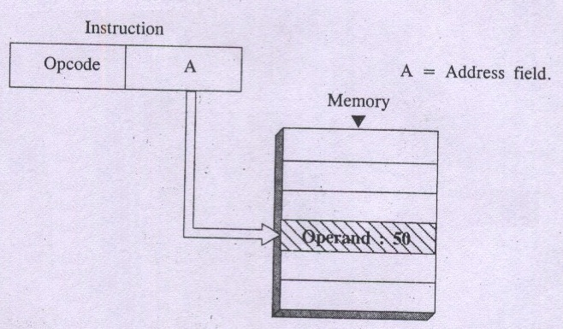
Absolute (Direct) mode
Here operand resides in Memory and its address is given explicitly in the address field of an instruction. This scheme need only one memory reference in addition to instruction fetch cycle and no further calculation is required to compute operand address.

Slide 13
Absolute (Direct) mode
Direct addressing scheme is simple to use and easy to implement without the requirement for additional hardware.
However it offers only limited memory address space.
Examples
Move LOC,R0
Load P
Store S

Slide 14
DIGITAL DESIGN AND COMPUTER ORGANIZATION
3. Register mode T2:Ch2 2.5
Department of Computer Science and Engineering

Slide 15
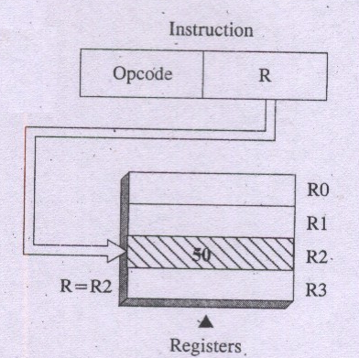
Register Addressing mode
In this scheme, the operand is the contents of a register appearing in the instruction i.e A=R
example
Add R1,R2

Slide 16
Register Addressing mode
Advantages of this scheme :
No memory reference
A few bit address to indicate register location
Speedy execution since register is inside the processor
& has low access time.
Disadvantages of this scheme :
Limited address space as number of registers are less
in many of the processors.

Slide 17
DIGITAL DESIGN AND COMPUTER ORGANIZATION
4. Indirect mode T2:Ch2 2.5
Department of Computer Science and Engineering

Slide 18
Indirect Addressing mode
The effective address of the operand is the contents of a register or memory location whose address appears in the instruction
By referring to this address (EA), the required operand
can be fetched from memory.
Example: Add (A), R0 i.e. EA = (A) i.e. contents of A is B
Here B is effective address of desired operand in memory

Slide 19
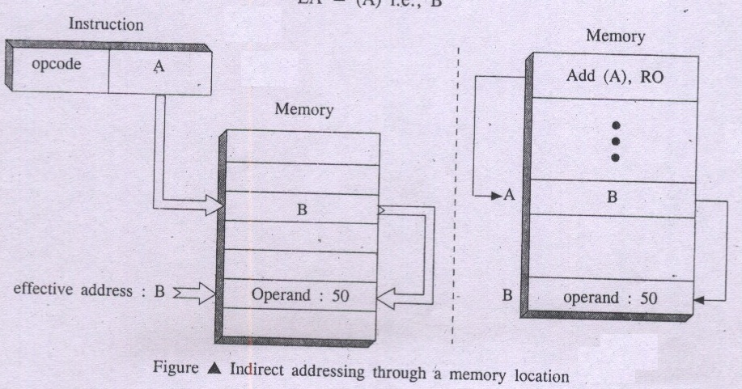
Indirect Addressing mode

Slide 20
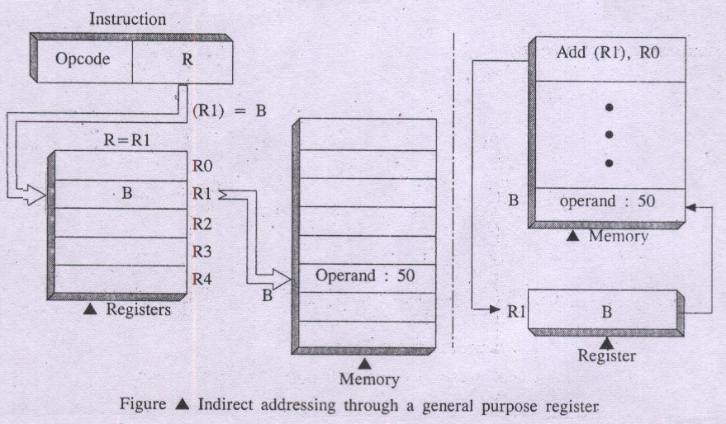
Register Indirect Addressing mode
Here, instruction specifies a register in the CPU whose contents give the effective address of the operand in Memory.
For example Add (R1), R0 i.e. EA = (R1) i.e. contents of R1 is B

Slide 21
Indirect Addressing mode-
Program to add list of n numbers
Address Contents
Move N, R1
Move #NUM, R2
Clear R0
LOOP Add (R2), R0
Add #4, R2
Decrement R1
Branch > 0 LOOP
Move R0, SUM
Notes:
R0- sum
#num- address (or starting location) of the array of numbers
# symbol indicates an immediate value or address constant

Slide 22
Indirect Addressing mode
The advantage of Register Indirect Addressing:
It uses one less memory reference (memory read operation)-You don’t have to fetch both the operand and its address from memory separately.
Address field of the instruction uses a fewer bits to
specify a register -example, a register code might use 3 bits (for 8 registers) instead of 16 bits for a memory address.
Register indirect addressing can be specified with
Effective Address EA = (R) i.e. B
Advantages of Indirect addressing:
a wider address range to refer to a large number of memory locations.
Disadvantage of Indirect addressing:
2 or more memory references (memory read operations)
required to fetch the desired operand in memory.
Notes:
Indirect addressing provides a wider range of addressable locations because the address itself is stored in memory, and can change dynamically.

Slide 23
Indirect Addressing mode
The Register or memory location that contains address of operand is called pointer
Consider C language snippet:
A=*B
equivalent :
Move B,R1
Move(R1),A
Using indirect addressing:
Move (B),A

Slide 24
DIGITAL DESIGN AND COMPUTER ORGANIZATION
5. Indexed mode T2:Ch2 2.5
Department of Computer Science and Engineering

Slide 25
Indexed Addressing mode
Here, effective address of the operand is generated
by adding a constant value to the contents of a register.
This constant value may be either an offset value called
displacement or beginning address of data/operand array
in main memory (Base).
Indexed addressing mode is symbolically represented as X(R)
👉Here X denote a constant and R is name of the register
involved in Indexing.
Effective address EA of the operand is given as
EA = X + [R]
👉Contents of index register are not changed during the
process of address generation.

Slide 26
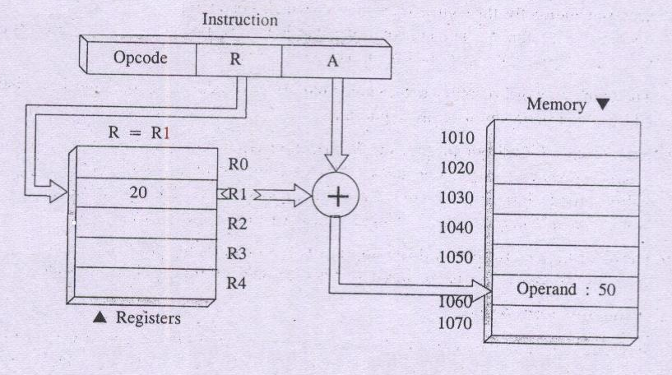
Indexed Addressing mode
A = 1040 = X; constant X corresponds to a memory location
(R) = 20 i.e. Index or offset value
EA = A + (R) = 1040 + 20
EA = 1060 at which you will find desired operand 50

Slide 27
Indexed Addressing mode
You can use indexed addressing mode in two ways
A constant value X defines here beginning address of
operand in memory and index register Ri contains offset value (Displacement)
👉 For example 1040 in the following instruction:
Add 1040 (R1), R2 X=1040 R1=20 offset
II) A constant value X defines an offset and index register Ri contains beginning address of operand in memory.
👉 For example 20 in the following instruction:
Add 20(R1), R2 X=20 R1=1040

Slide 28
Indexed Addressing mode
Index addressing is fast and is excellent for manipulating data structures such as arrays as all you need to do is set up a base address then use the index in your code to access individual elements.
Another advantage of indexed addressing is that if the array is re-located in memory at any point then only the base address needs to be changed. The code making use of the index can remain exactly the same.

Slide 29
Indexed Addressing mode Example
Example: Add 20(R1),R2
Add 2000(R3),R4
Assume that a list of scores of the student beginning at location LIST as shown in the following diagram
A 4 word memory comprises a record that stores relevant info for each student
Compute the sum of all scores obtained on each of the test and store these sums in memory locations SUM1,SUM2,SUM3

Slide 30
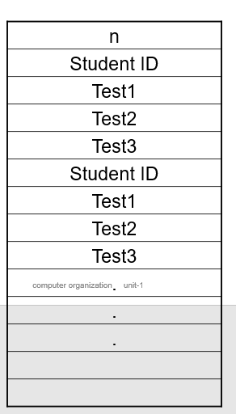
Indexed Addressing mode
N 5000
LIST 5004
LIST+4 5008
LIST+8 5012
LIST+12 5016
LIST+16 5020

Slide 31
Indexed Addressing mode
Move #LIST, R0
Clear R1
Clear R2
Clear R3
Move N, R4
LOOP Add 4(R0), R1
Add 8(R0), R2
Add 12(R0), R3
Add #16, R0
Decrement R4
Branch>0 LOOP
Move R1, SUM1
Move R2, SUM2
Move R3, SUM3
Notes:
R1,R2,R3 sum of test1 test2 test 3

Slide 32
Indexed Addressing mode
Advantages of Index mode
is the flexibility it offers to access relative memory locations
Disadvantages of Index mode
* Is the complexity of computing effective address.
* The instruction requires to have two address fields
at least one of which is an explicit number.

Slide 33
Indexed Addressing mode
Several variations of this basic form provide a very efficient access to memory operands in practical programming situations.
For example, a second register may be used to contain the offset X, in which case we can write the Index mode as
(Ri, Rj)
The effective address is the sum of the contents of registers Ri and Rj.
The second register is usually called the base register.
This form of indexed addressing provides more flexibility in accessing operands, because both components of the effective address can be changed.

Slide 34
Indexed Addressing mode
Another version of the Index mode uses two registers plus a constant, which can be denoted as
X(Ri, Rj)
In this case, the effective address is the sum of the constant X and the contents of registers Ri and Rj.
This added flexibility is useful in accessing multiple components inside each item in a record, where the beginning of an item is specified by the (Ri, Rj) part of the addressing mode.

Slide 35
DIGITAL DESIGN AND COMPUTER ORGANIZATION
6. Relative mode T2:Ch2 2.5
Department of Computer Science and Engineering

Slide 36
Relative mode
This scheme supplies the relative position of the memory
operand to be located.
It’s like index mode only but program counter register PC
substitutes for base address contents
Commonly used to specify the target address in branch instruction
Relative Mode specify Effective Address by a notation:
X(PC)
Effective address is EA = [ PC ] + X
Branch > 0 loop Here jump value / displacement ± X
Notes:
Access location x bytes away from PC

Slide 37
DIGITAL DESIGN AND COMPUTER ORGANIZATION
7. Auto increment mode T2:Ch2 2.5
Department of Computer Science and Engineering

Slide 38
Auto increment mode
The EA of the operand is the contents of a register specified in the instruction
After accessing the operand, the contents of this register are
incremented automatically to point to the next operand
in contiguous memory locations.
Notation for Auto Increment Mode: (R_{i}) +
For example: Add (R2) +, R0
Use of Auto Increment mode instruction eliminates the use of
explicit increment instruction

Slide 39
Auto increment mode
Implicitly, the increment amount is 1 when the mode is given in this form. But in a byte-addressable memory, this mode would only be useful in accessing successive bytes of some list.
To access successive words in a byte-addressable memory with a 32-bit word length, the increment must be 4. Computers that have the Autoincrement mode automatically increment the contents of the register by a value that corresponds to the size of the accessed operand.
Thus, the increment is 1 for byte-sized operands, 2 for 16-bit operands, and 4 for 32-bit operands. Since the size of the operand is usually specified as part of the operation code of an instruction, it is sufficient to indicate the Autoincrement mode as (Ri)+.

Slide 40
Auto increment mode
Program to add n numbers using autoincrement
MOVE N,R1
MOVE #NUM1,R2
CLEAR R0
LOOP ADD (R2)+,R0
DECREMENT R1
BRANCH >0 LOOP
MOVE R0,SUM

Slide 41
DIGITAL DESIGN AND COMPUTER ORGANIZATION
8. Auto decrement mode T2:Ch2 2.5
Department of Computer Science and Engineering

Slide 42
Auto decrement mode
Here, content of a register specified in the instruction is
Decremented to denote effective address of next operand in
Successive memory location.
Notation for Auto Decrement Mode: - (R_{i})
For instance
Add – (R2), R0
It allows accessing of operands in decreasing order of memory address..

Slide 43
Auto decrement mode
The actions performed by the Autoincrement and Autodecrement addressing modes can obviously be achieved by using two instructions, one to access the operand and the other to increment or decrement the register that contains the operand address. Combining the two operations in one instruction reduces the number of instructions

Slide 44
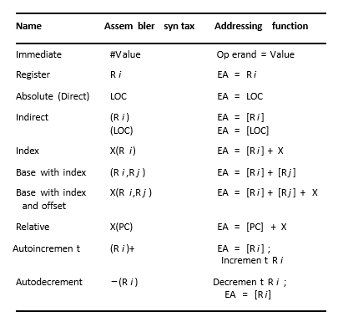
Addressing Mode
The different ways in which the location of an operand is specified in an instruction are referred to as addressing modes.

Slide 45
MCQ
In Register Addressing Mode, which of the following is correct? a) Operand is always stored in memory b) Operand is always a constant c) Operand is stored in CPU register specified in instruction d) Operand is fetched using Program Counter (PC)
Which addressing mode is commonly used to implement looping with counters? a) Immediate b) Indexed c) Register Indirect d) Relative

Slide 46
MCQ
In Register Addressing Mode, which of the following is correct? a) Operand is always stored in memory b) Operand is always a constant c) Operand is stored in CPU register specified in instruction d) Operand is fetched using Program Counter (PC)
Answer: c) Operand is stored in CPU register specified in instruction
Which addressing mode is commonly used to implement looping with counters? a) Immediate b) Indexed c) Register Indirect d) Relative
Answer: b) Indexed

Slide 47
MCQ
Which of the following addressing modes does NOT require memory access for operand fetch? a) Register Addressing b) Indirect Addressing c) Direct Addressing d) Indexed Addressing
Which of the following addressing modes requires two memory references (excluding instruction fetch) to access an operand? a) Immediate b) Register Direct c) Indirect d) Indexed

Slide 48
MCQ
Which of the following addressing modes does NOT require memory access for operand fetch? a) Register Addressing b) Indirect Addressing c) Direct Addressing d) Indexed Addressing
Answer: a) Register Addressing
Which of the following addressing modes requires two memory references (excluding instruction fetch) to access an operand? a) Immediate b) Register Direct c) Indirect d) Indexed
Answer: c) Indirect

Slide 49
THANK YOU
Team DDCO
Department of Computer Science

